Slide 1

CULTURAL ORIENTATION

Slide 2
What We’ll Cover…
Emergencies & Safety
Role of Resettlement Agency
Important Documents
Money Management
Rights & Responsibilities
U.S. Laws
Housing
Health & Hygiene
Employment
Education
U.S. Cultural Norms
Cultural Adjustment

Slide 3
EMERGENCIES!
1 .WHAT NUMBER DO YOU CALL IN AN EMERGENCY?
2.WHAT IS AN EMERGENCY? WHAT ARE SOME EXAMPLES?

Slide 4



EMERGENCY: A situation where someone’s life is at risk
Examples: fire, crime,
Someone not breathing,
bleeding uncontrollably
Someone breaking into your apartment
Important to memorize address and phone number both for an emergency!
CALL 911
If you cannot explain the problem just say, “Help” or “Emergency” and do not hang up the telephone. The open telephone line will help the operator know where you are.
Ask for an interpreter
Don’t call case manager in an emergency, call 911
Notes:
Only call 911 in an emergency. Calling uses expensive resources and may take away life saving resources from others experiencing an emergency so do not abuse it. 911 is not a taxi.
Call 911 if you feel threatened or unsafe .

Slide 5


Child Safety
Children should not be left alone if they are under 12 years old.
Children should not be left to play alone outside.
Children under 8 must be in proper car seat when riding in a car (also all adults must wear seatbelts). This is the law!
Make sure children know not to play in the road.
Make sure children know never to get in a car with someone they don’t know.

Slide 6

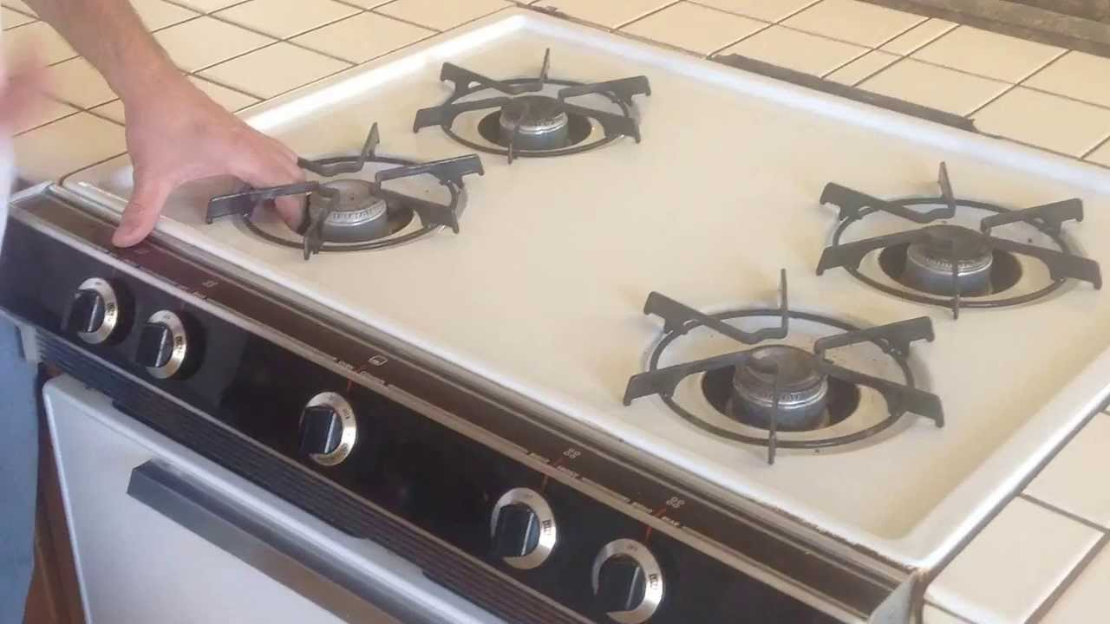
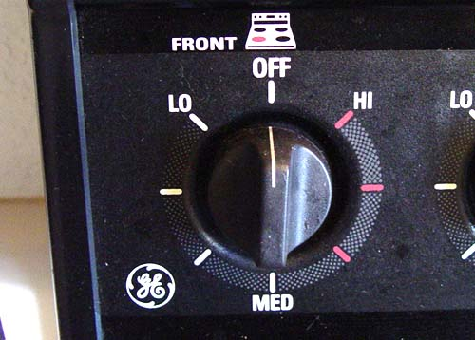
Home Safety
It is important to know how to use the things in your apartment safely. Please let CM know if you have any questions.
Be sure to lock doors when they leave/before they go to bed
Be sure to turn off the stove/oven when
it’s not in use!

Slide 7


Water Safety
Never leaven young children unattended in the bathtub!
Don’t leave children unattended near water for any amount of time
  Drowning can happen silently, with little or no noise or splashing.
  Drowning can happen quickly! Once a child starts struggling, there is less than 1 minute to respond.
  Even if your child has learned how to swim, they can still be at risk of drowning.
  Even at a public swimming area with a lifeguard, you are responsible to watch your children in the water.

Slide 8

Role of Resettlement Agency
The goal of refugee resettlement is to help you become self-sufficient in your new community by teaching you and connecting you with resources that will help you learn how to take care of your needs and have a positive experience in the U.S.

Slide 9
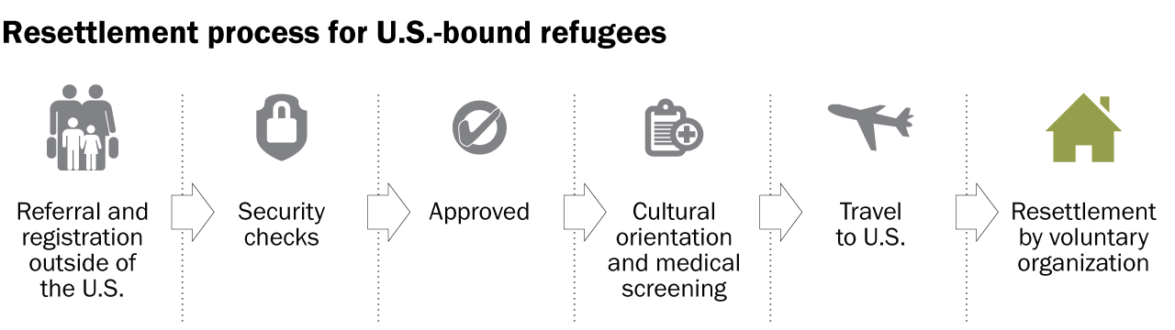
90 days of case management (R&P), and ongoing case management up to 5 years in the U.S.
Not a government agency, but in a contract with the government to provide particular services
Services look different across agencies, states, and individual cases.

Slide 10




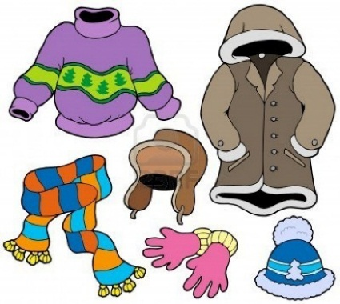
Connect you to Basic Needs
Your wants may be different than
what the government says is a basic need.

Slide 11



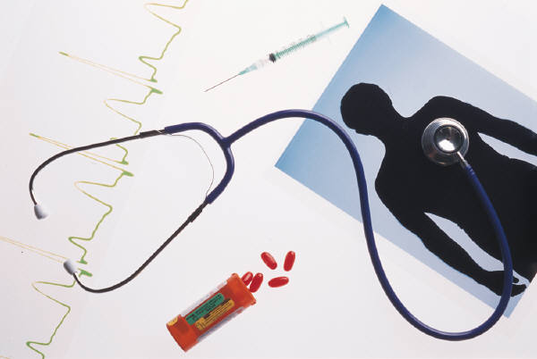
Provide Core Services
IRIS provides core services, such as applying for public assistance, social security, school enrollment, and connection to health care.

Slide 12

Important Documents
What Important Documents Do You Have?

Slide 13
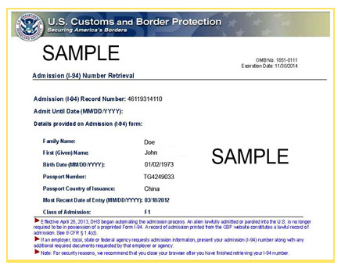
Refugee Status/I-94
Your official status in the United States is “Refugee”- (This is your current legal status in the US – you can work, go to school, don’t need to walk around with the documents constantly)
I-94: This is the legal document that shows your refugee status and shows you are eligible for certain services. (keep in a safe place!)
Your official status will change from ‘refugee’ to ‘legal permanent resident’ when you are granted your green card
Have clients show you their I-94s
Notes:
Skip this slide for SIVs.

Slide 14
Social Security Card
Every person eligible to work in the U.S. is assigned a social security number, including citizens. The number shows your identity.
You will need the number to apply for jobs, housing, public assistance of any kind, social services, and a bank account. Sometimes it is needed to get electricity, telephone, or internet service.
Memorize your SSN and put the card away in a safe place. Do not carry it with you unless absolutely necessary!
Do not cover it in plastic or bend it.
NEVER give your SSN to someone over the phone unless you have initiated the call and know exactly who you are talking to and why they need the number. No official government agency will ever call you and ask you to provide your SSN in order to give you a benefit of some kind.
When In Doubt Don’t Give It Out!
Notes:
Beware of criminals who may try to steal your information pretending to be someone they’re not, as they especially may try to target immigrants who aren’t as used to the American systems.

Slide 15
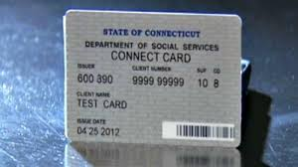
DSS/EBT Card
Have you received your EBT card yet?
Do you know how to use the EBT card and what items you can use the card to purchase?
  When you make a purchase, the receipt shows your remaining balance.
Notes:
Cannot purchases tobacco or alcohol with EBT funds. Also cannot purchase “ready-to-eat” food with EBT funds.

Slide 16

Medical Insurance Card
Have you received your HUSKY card?
Where do you need to bring this card?
  All medical appointments
  The pharmacy for prescriptions

Slide 17
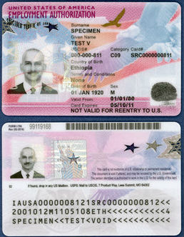
Employment Authorization Document (EAD)
Only for refugees (not SIVs)
Can take around 90 days to arrive
Serves as a government-issued photo ID
Valid for 2 years but will be replaced by your green card when you apply after one year
Notes:
Skip this slide for SIVs.

Slide 18
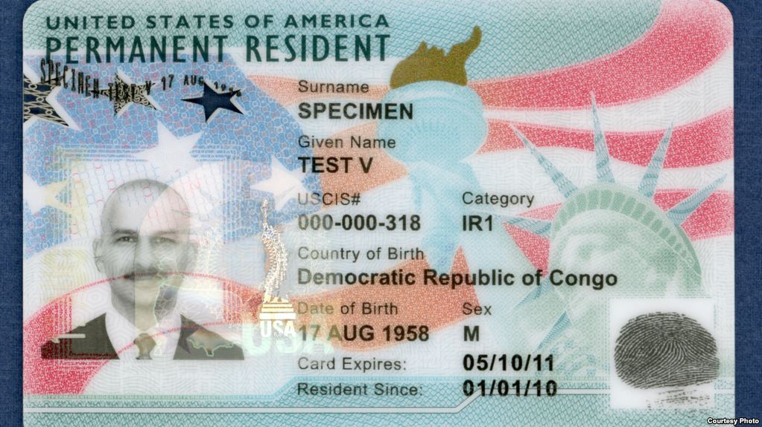
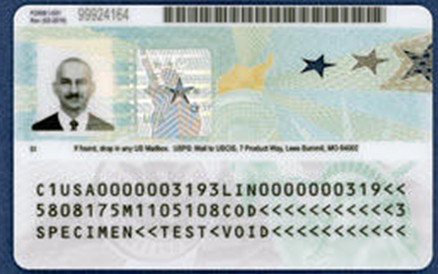
Green Card
Replaces your EAD card, should be applied for one year after arrival (for refugees).
SIVs will get instead of EAD cards (can take up to 4 months).
IRIS legal team can help refugees apply for their green card after one year in the U.S.

Slide 19





Budget
In order to properly budget, we need to understand how much money we have and where it comes from. Let’s look at your family’s financial assistance.

Slide 20
Source 1 - Resettlement Grant
$1075/person
One-time Grant
Does not need to be repaid
Government requires IRIS to use this money to secure Basic Needs (i.e. food, housing, furniture, medicine, etc.) before and after you arrive.
This money cannot be given to you directly (government policy).

Slide 21

Source 2 - Public Assistance
Public Assistance - comes from the State Government (DSS), not IRIS:
  Temporary Family Assistance (TFA) – For families (couples with children under 18) OR
  Refugee Cash Assistance (RCA) – For Singles or Couples without children under 18
  Supplemental Nutrition Assistance Program (SNAP) – money to be used only for food
Notes:
Can also mention Women, Infants, and Children (WIC) – additional food vouchers for pregnant/nursing women and children under 5 years (referral at RHA)

Slide 22

Managing Finances
You are responsible for managing your own personal finances. Learning how to budget is an important skill.
In order to create a budget, it is important for you to know your monthly income and expenses, such as rent, utilities, and groceries.
For budgeting purposes, it will be important to identify what your family wants versus what your family needs. Some of the wanted items may be expensive and unnecessary, and could take away from the needs of your family.
It’s important to take care of your needs and become financially stable before sending money home to family abroad.
Notes:
From CORE website

Slide 23

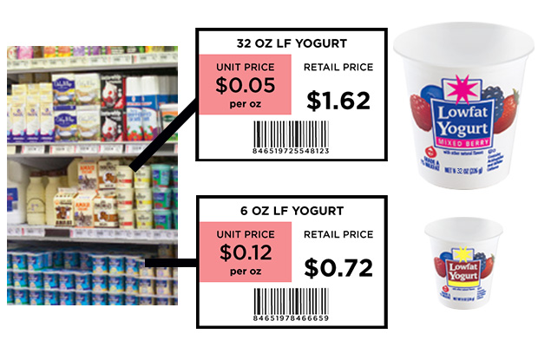
Grocery Budget Tips
Know how much money is on your EBT card, what day it is added to your card each month and make a plan so this money will last the entire month.
Have a list and plan ahead what you need, this will help limit the amount of extra items you are spending money on.
Pay attention to the unit price on labels (see example).
Buy off brands (checking the unit price will help to show what the best deal is).
If you can avoid it, do not shop while you are hungry.
Eat leftovers! Take advantage of your fridge and save leftover food items.

Slide 24

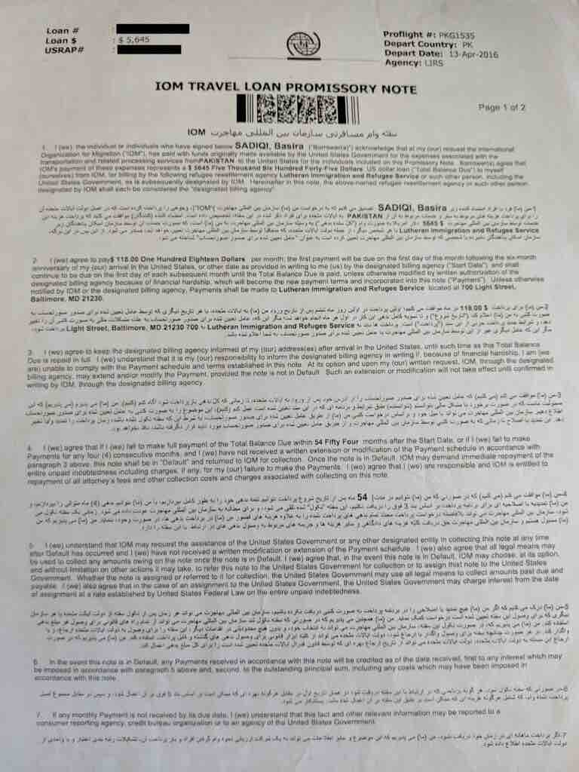

Responsibility - Travel Loan
Do you remember signing an agreement before you left ______ (country) that you would pay a certain amount for your travel expenses?
You will get a bill in the mail 4-5 months after arrival. It will tell you how much you must pay each month.
What do you think you should do if you can’t pay the full amount?
  importance of calling!
It’s important to repay the entire loan
  (credit, pool of money to bring other refugees, could affect citizenship application).

Slide 25

Responsibility - Selective Service
All men between the ages of 18-25 (until turning 26) living in the U.S. are required by law to register for selective service with the military. (Failing to do so can result in a fine up to $250,000 and/or jail time up to 5 years).
If the U.S. goes to war and there are not enough people already in the military, they may require people on this list to join the military.
This is very unlikely to happen.
Note: Help family fill out/mail selective service if you have not yet done so.

Slide 26
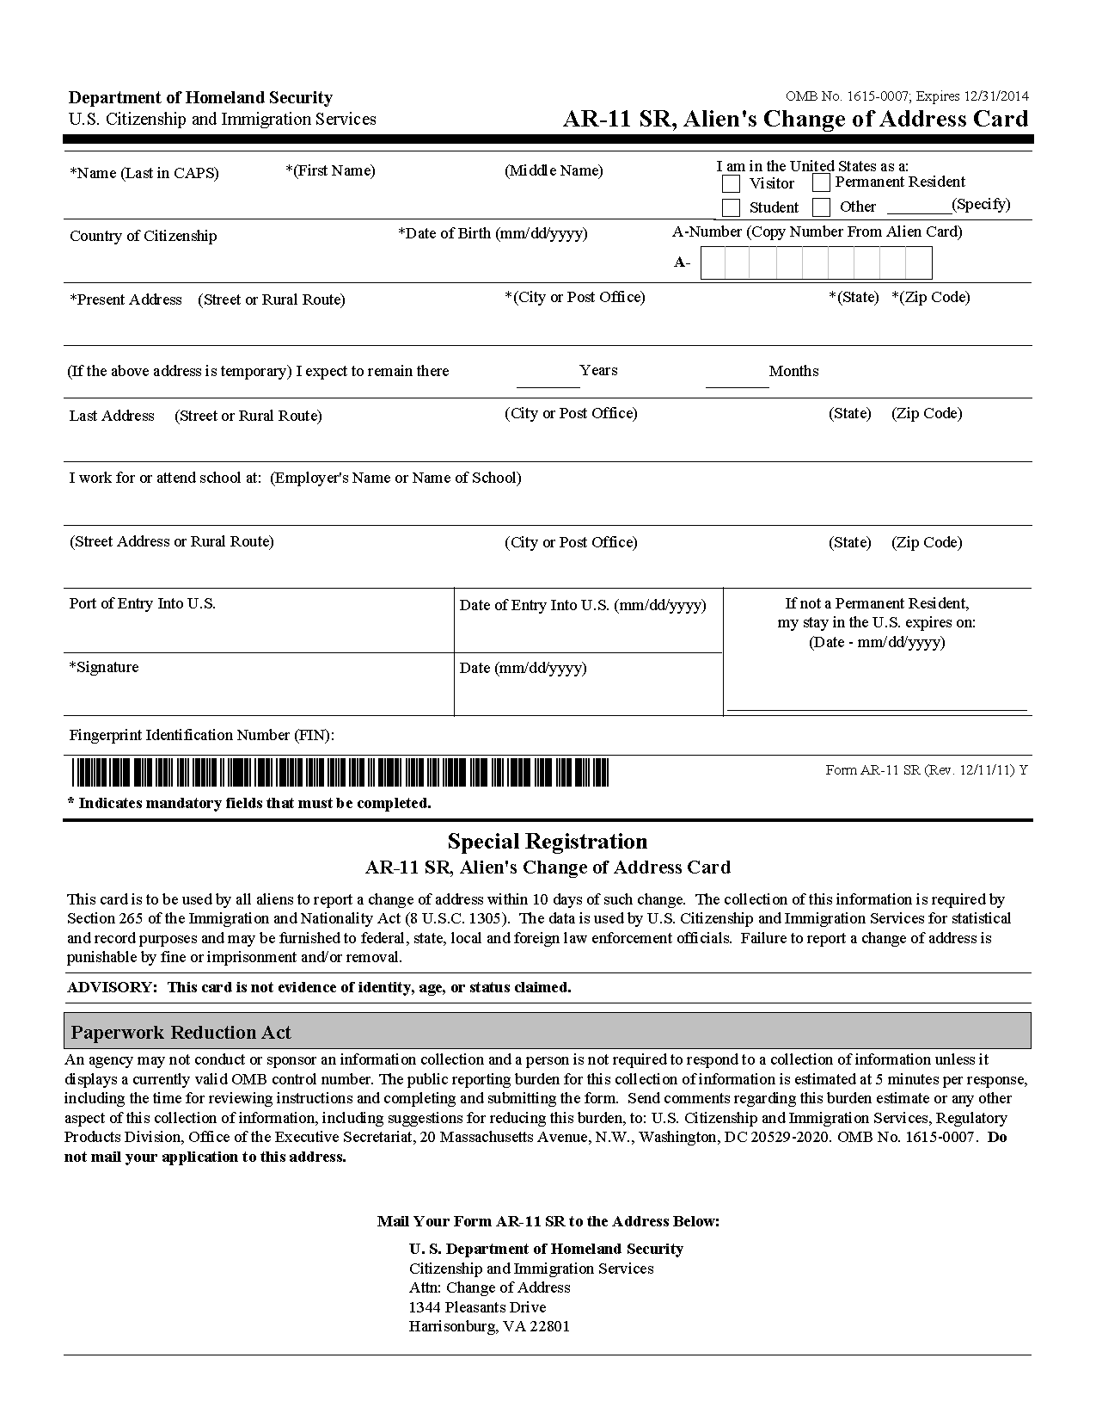
Responsibility: AR-11
Until you become a U.S. citizen, you must inform the government any time you change addresses.
To do this, you can complete one AR-11 form per person online.
This informs US Citizen and Immigrant Services of your new address.
It must be submitted within 10 days of moving.

Slide 27


U.S. LAWS
The U.S. is governed by rule of law to protect people’s freedom. Anyone living in the U.S. must follow these laws.
These laws may govern behavior in public or in private family life.
In the United States, you can be punished if you break the law, even if you did not know about the law you broke.
Let’s look at some common laws…

Slide 28
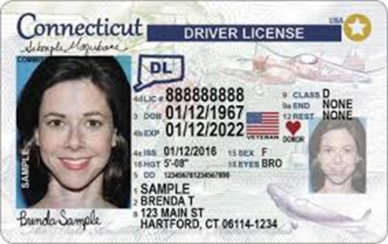


DRIVING LAWS
You must have a driver’s license to operate a vehicle. You must also have car insurance.
You must wear a seatbelt.
Children under age 8 must be in a car seat.
It is illegal and very dangerous to drink alcohol and drive.

Slide 29




ALCOHOL
It is illegal to drink under the age of 21, or provide alcohol to anyone under the age of 21.
It is illegal to drink and drive.
It is illegal to drink alcohol in public places such as parks and on the streets.

Slide 30



Cigarettes/Tobacco Use
*You must be at least 21 years old to purchase/use Tobacco in Connecticut. (Ages vary from state to state).
*There is no smoking in most public places. If you see this sign it is against the law to smoke.

Slide 31



Drugs/Illegal Substances
It is illegal to purchase, sell, or use narcotics or marijuana. It is also illegal for anyone to buy/use someone else’s prescription drugs, or for you to share or sell your prescription drugs with others.

Slide 32






NO Indecency/Urinating in Public; Spitting; Littering
It is illegal to urinate and or defecate in public areas. It is also against the law to expose your private parts in public.
Spitting is not considered culturally acceptable in the U.S. and may be lead to fines in certain places.
Littering is often a criminal offense, punishable with a fine. It is also bad for the environment and our community!

Slide 33
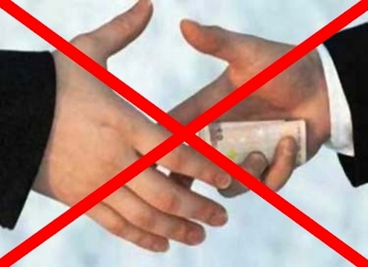
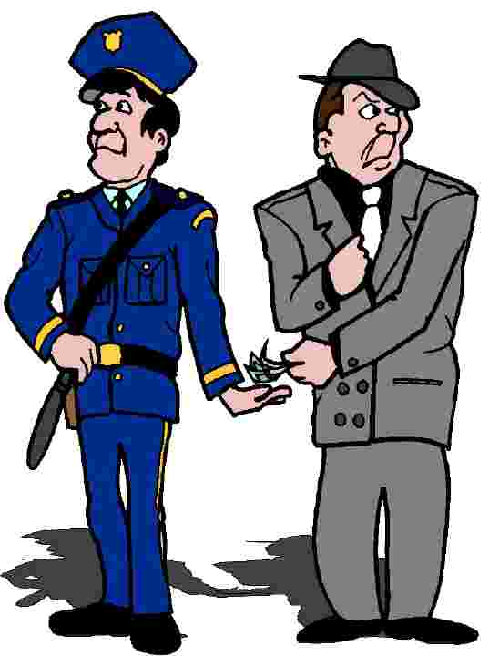
Bribery/Extortion
Bribery is illegal in the U.S. You may not pay or offer favors to police officers or other public officials to avoid the law.

Slide 34


Income Taxes
You must pay your income taxes each year. It is a serious crime to evade taxes.
You must fill out and send an income tax form to the federal and state government before April 15th every year.
You can fill the forms on your own or there are many agencies (not IRIS) that can assist with this. Only trust a professional who is authorized to give tax advice.

Slide 35



Sexual Harassment
Offensive comments or behaviors of a sexual nature are illegal. Any comments of a sexual or personal nature is considered inappropriate.
Notes:
If at work: Report such behaviors to a trusted supervisor or the Human Resources department at your workplace.

Slide 36









Freedom of Expression
Everyone has the right to freedom of opinion and expression; this right includes freedom to hold opinions without interference.
Circa- Article 19 of the Universal Declaration of Human Rights
Examples of freedom of expression:
Religion
Sexual orientation
Dress (though employers may have dress codes)
While you may not agree with someone else’s beliefs/decisions, their right to express themselves is protected under law. This law also protects you from discrimination by others.

Slide 37


Physical Abuse
It is illegal to physically abuse or threaten anyone including your spouse and children. You must find other ways to discipline your children.
In the U.S., abuse is not just a “private matter.” It concerns the whole community. Law enforcement (and your neighbors) are looking out for abusive and illegal behaviors.

Slide 38
Domestic Violence
Domestic violence is the physical, sexual, emotional, economic, or psychological abuse from one family member towards another.
Multiple forms of domestic violence can occur at the same time.
Domestic violence can happen to anyone.
Domestic violence is illegal and can result in arrest and/or a monetary fine, which can also result in a permanent criminal record.
There are confidential and free services available to anyone in a domestic violence situation, including both men at risk for abusing their family and women who have experienced domestic violence.
Notes:
Specific examples:
-Hitting, punching, or any other form of physical violence against your partner.
-Making or carrying out threats against your partner.
-Verbally putting your partner down, making them feel bad about who they are as a person.
-Preventing your partner from working.
-Restricting your partner’s access to money.
-Isolating your partner from others.
-Using your children to make your partner feel guilty.
-Not acknowledging the abuse, and/or blaming the other partner for the abuse.
These are only a few examples of domestic violence.

Slide 39
For Men: What Are Your Options?
Sometimes, there are situations where there isn’t domestic violence occurring in the household, but a man may be at risk for abusing his family. This sometimes occurs when there is high stress and a lot of tension within the family.
If you or someone you may know believes they are at risk for this, there are confidential programs and services available to prevent this from happening.
For information about these programs and services you can call:
  The National Domestic Violence Hotline: 800-799-7233
  United Way (CT): 211

Slide 40
For Women: What are your options?
If you are in a safe place and not in immediate danger, you can call:
  The Connecticut Coalition Against Domestic Violence: 888-774-2900
  The MILLA Project: 203-936-8039
  United Way: 211
All services you receive from these organizations are free and confidential, and are available to anyone impacted by the domestic violence situation, including children.
These services are available to everyone, regardless of their immigration status, race, religion, ethnicity, and/or native language.
When you call any of these agencies, they will listen to you, and inform you of your options. They are there to help you make whatever decision you are comfortable making.
Notes:
When you call a domestic violence agency, some of the services offered include:
Shelter Assistance:
The agency will help you find a shelter, which is a safe place for you and/or your children to live temporarily. Most shelters offer services to help you become independent and eventually leave the shelter.
Counseling:
Someone who you can talk to about your situation or past experiences.
Advocacy:
Someone who will provide you with your options, and help you with your decision-making.
Life Skills Assistance:
Helps you build the skills necessary to make a new life for yourself, and/or your children after surviving domestic violence.
Legal Aid Assistance:
Helps you through any criminal proceedings or any legal paperwork required.

Slide 41



What Can Happen If You Break A Law
  Breaking the law has consequences, some of which may impact your immigration status.
  Penalties will depend on the seriousness of the crime.
  Penalties may include: fines, jail time, and/or deportation.
Notes:
It’s important clients know that their refugee/permanent status could be revoked if committing a serious crime.

Slide 42

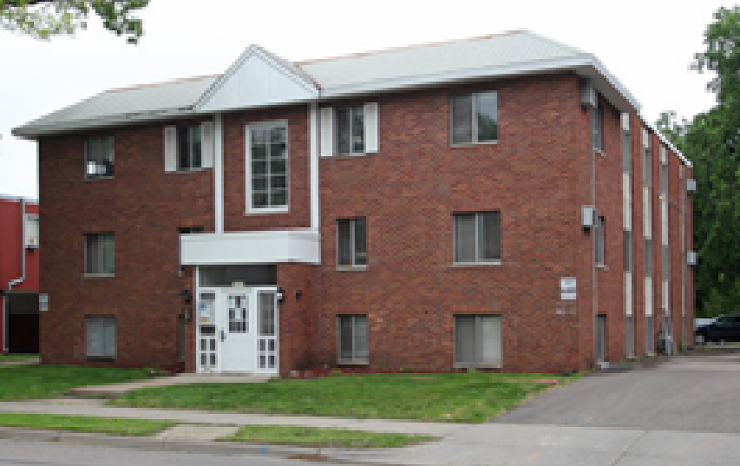
Housing
Safe
Sanitary
Affordable
Houses here are equipped with the essentials (fridge, stove, cupboards, bathroom, heat)
NOT required to have a washing machine, microwave, TV, or air conditioning
Not Over-Occupancy (state laws)
As Close To US Tie/Support as possible

Slide 43

LEASE AGREEMENT:
In the United States, in order to rent a unit you must sign a legal document called a lease.
The terms of lease are set by the property owner.
Typical lease durations are one year, however some landlords will offer a shorter lease agreement. This is not to be expected.
In order to abide by the terms of the lease, you should read and understand before you sign.

Slide 44

How to Build a Good Relationship With Your Landlord ☺
Pay your rent on time! (Paying bills on time builds credit, which helps for loans, finding future places to rent, etc.)
Take care of the property. Call your landlord if anything is broken or if you want to move. You can also ask IRIS to assist in contacting your landlord.
Be a good neighbor! (How!? not being too loud, taking out garbage, not making a mess in public spaces).

Slide 45
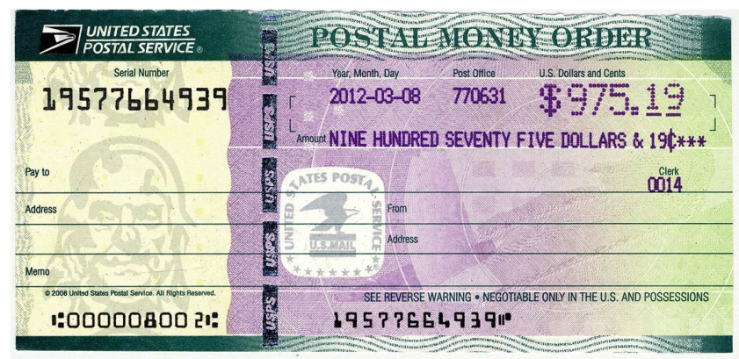
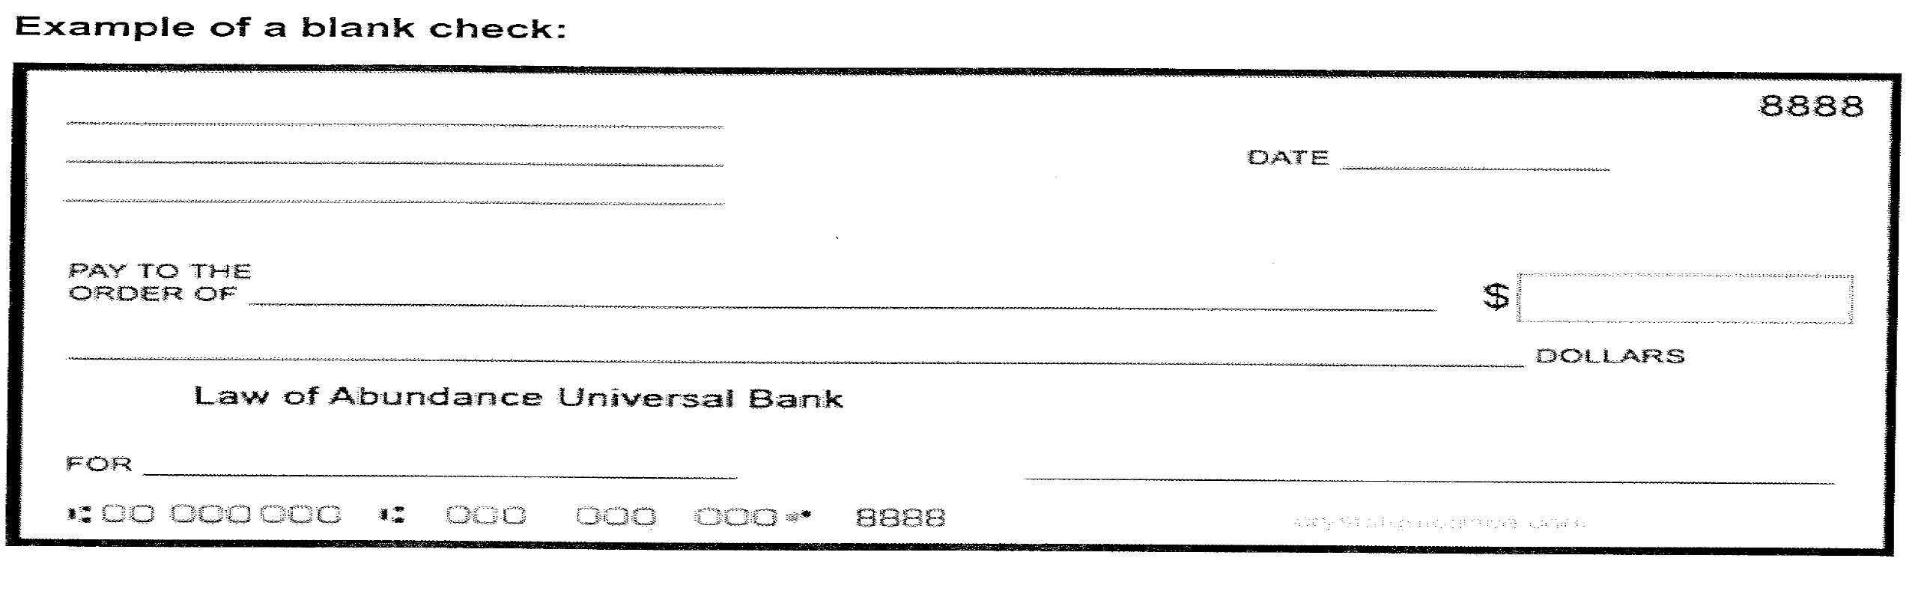

Paying Rent:
Money Order: You may pay rent via money order. To do this go to a location that sells money orders (post office, pharmacy, grocery store) with the cash you wish to send (along with a little extra for the processing fee). IRIS can provide education on how to obtain and send a money order.
Bank Account: You may also pay rent through a bank account. To do this, you will need to choose/go to a bank, open an account, and order checks. Some of your regular bills may also have online payment options using your bank account information.
You will send your money order or check in the mail. Therefore you will need to learn how to send mail.

Slide 46
Consequences to moving before lease has ended ☹:
  1. Limited assistance in rent payment from IRIS as some resettlement money has already been spent on the first housing option.
  2. Poor credit (which will impact ability to find a job, open a bank account, etc.)
  3. Very difficult to find a future place to rent (landlords do not like to risk renting to those who left before their lease has ended before)
Notes:
Could lose security deposit.

Slide 47
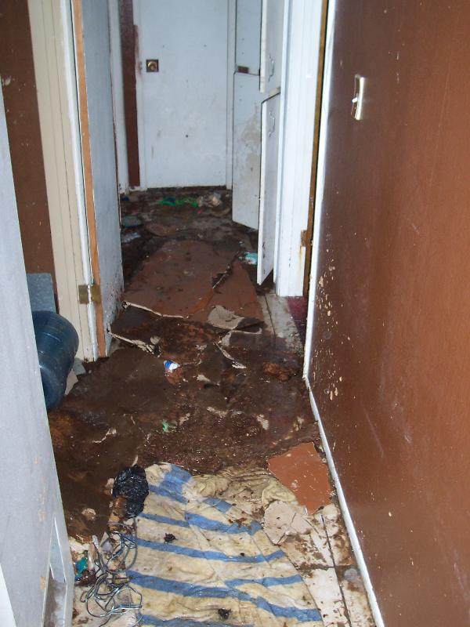


Housing Cleanliness
Important to regularly clean your house/apartment
Take out the trash regularly (especially meat, eggs or other smelly foods)
No littering in apartment hallways or outside
Have questions about how to keep things clean/how to use cleaning supplies ask your family/friends or case manager.

Slide 48
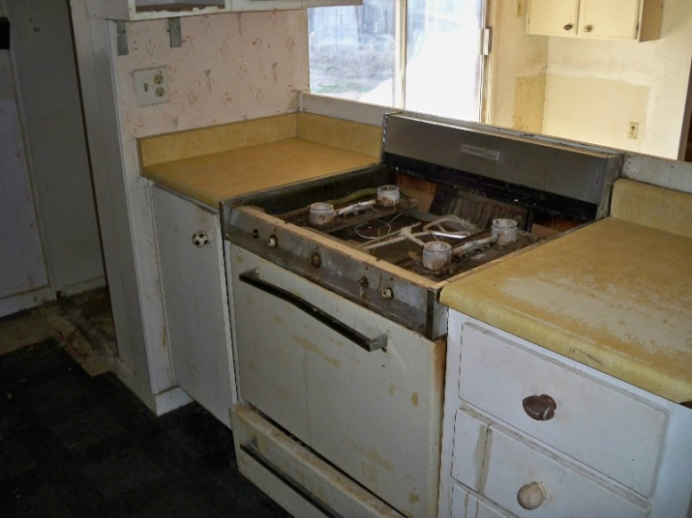

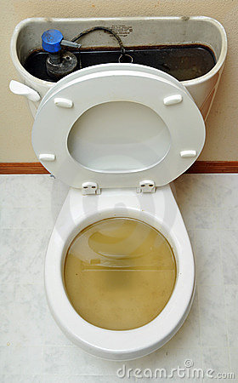
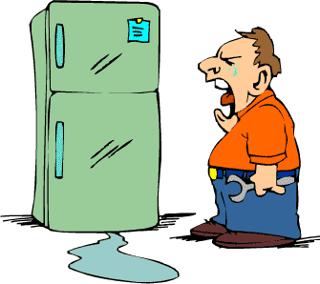

When To Contact Your Landlord…
Broken Items

Slide 49
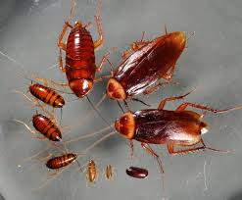
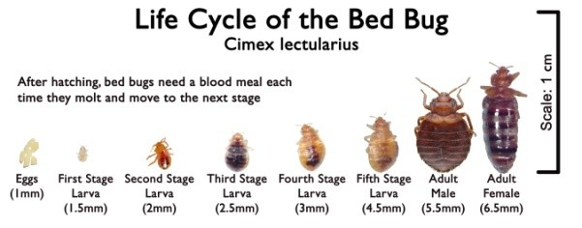
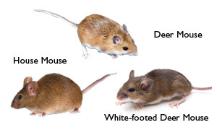
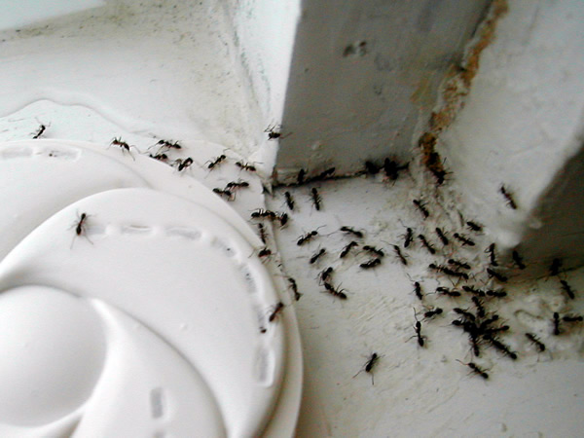

When To Contact Your Landlord…
Bug/Rodent problems
Note: Bed bugs are very hard to get rid of. You need to be careful not to bring them in your home! (see housing cleanliness slide)

Slide 50


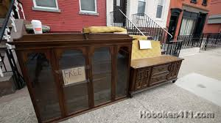
Housing Cleanliness: Bed Bugs
Do NOT pick up furniture from the road or by dumpster! They could have bed bugs!
If you know friends or family have bed bugs in their home, use extreme precaution. Bed bugs hitchhike on clothing and other items (consider meeting in a public space instead of at one another’s homes).
If you think you have come into contact with bed bugs, immediately wash and dry your clothing on the hottest setting the fabric can withstand, or store them in a sealed plastic bag until you are able to do so.
Let your case manager know if you think you may have bed bugs.

Slide 51

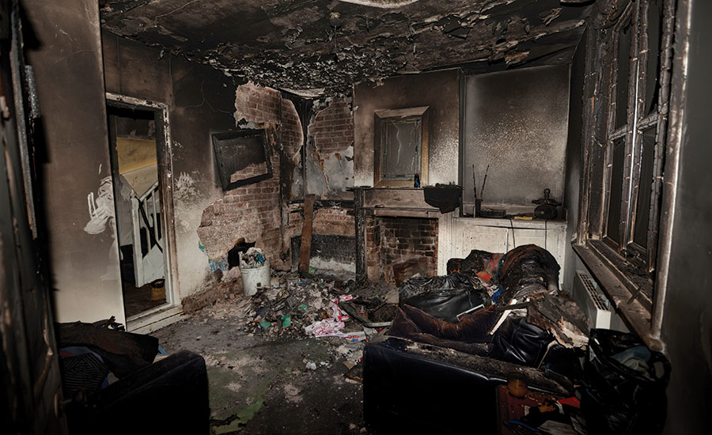
Smoke Alarms
If your smoke alarm is regularly beeping, it means the batteries need to be changed.
Batteries should be routinely changed every 6 months as well, regardless of beeping.
To ensure that your smoke alarm works, press and hold the button on the device until it beeps.
Smoke alarms are to alert you to fire and smoke in your home or apartment building. It is the law that there is a smoke alarm in/directly outside each room where people sleep and on every level of the housing unit. If your housing doesn’t have any/enough smoke alarms in the right places, let your landlord or case manager know!

Slide 52





What To Do If You Move:
Complete the AR-11 (USCIS)
Call Your Travel Loan Provider
Update DSS
Notify the Post Office
Call the Electric & Gas Companies
Contact Schools
Update Selective Service

Slide 53



Health & Hygiene
The U.S. Healthcare system can be confusing.
We will cover the basics for better understanding.

Slide 54


Types of Health Services
How severe your medical needs are will determine which type of services you will use
Primary care – Your “home” clinic. For scheduled appointments. They will keep all your medical records.
Urgent care – clinics open evenings and during the weekend, for an illness or injury that needs immediate care, but is not serious enough for a visit to the emergency room. You do not need an appointment.
Emergency Room – At the hospital, walk-in only (no appointments). This is where you go if you are severely ill or injured.
9-1-1 – Ambulance; if you cannot get to an emergency room on your own safely or if you need on-site medical treatment.
IMPORTANT: Do not call 9-1-1 for non-life threatening events. It costs a lot of money and may take life-saving resources away from others experiencing life threatening emergencies. Ambulances are not medical taxis!

Slide 55


Types of Health Services
Specialists – For specific health issues that require treatment from an expert. Appointments given by referrals from your primary care doctor.
Dental and eye care – Some clinics offer prove free or low cost dental or eye care; sometimes resources are provided at health screenings. If not you can ask your primary doctor or IRIS health coordinator.
Medical Social Workers – People who help you find resources to meet your medical needs; you can ask your primary care doctor to be connected to a medical social worker.

Slide 56

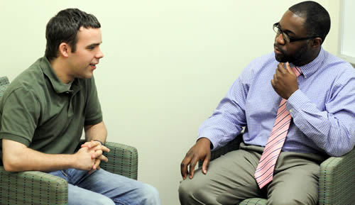
Mental Health Resources & Counseling
  If you are having trouble with day to day functions (such as sleeping or eating); if you often feel worried or overwhelmed; if you are continuously having bad dreams or memories; and/ or turning to alcohol or drugs to cope, there are doctors trained to help you.
  You can talk with these doctors if you’re having a hard time with the transition to the U.S.
  Please let your case manager know if you would like to see a doctor for help with any of this or talk to your primary care doctor if you prefer not to share with your case manager.
Notes:
From CORE website: Americans believe that mental health is as important as physical health. Mental health refers to how you feel, think, and behave as you cope with life. It also refers to how you handle stress. Good health care includes treatment by a mental health professional when it is needed.
NOTE: It’s important to show you take this topic seriously, even if clients make light of it.

Slide 57

Medical Interpretation
You have the right to interpretation services at all of your doctor appointments. It is a good idea when scheduling appointments to ask for an interpreter.
An interpreter’s job is only to interpret what is being said. Do not ask them for additional services or assistance.
If you are not happy with your interpreter services let the clinic know ASAP.

Slide 58
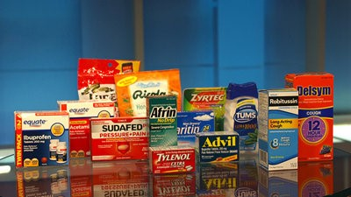

Medications
Some medications are “over-the-counter” medications can be bought at your local grocery store or pharmacy.
Other medications require your doctor’s permission to get. He or she will send your prescription to a pharmacy and you will then need to go pick it up from the pharmacy.
For refills, call the pharmacy with your RX number several days before you are going to run out of medication.

Slide 59




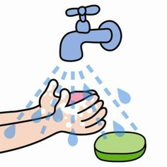
Preventative Health & Hygiene:
By being proactive and taking these measures it will lead to better health and therefore less time off work
Eat healthy
Drink lots of water
Exercise/Spend time outdoors
Shower Regularly/Practice good hygiene
Brush your teeth twice a day
Be up-to-date on immunizations
Schedule yearly exams with primary care doctor
Wash your hands after using the bathroom
Cover your sneeze and cough with your arm
Get adequate sleep (~8 hours)
Drink plenty of water, water from your sink is safe to drink! ☺
Notes:
From CORE website:
Cleanliness and Personal Hygiene: Most Americans bathe or shower every day, brush their teeth twice a day, shampoo their hair often, apply deodorant once a day, and wash their clothes frequently. Stores sell many kinds of products that help people avoid appearing dirty or having any odor of sweat. Personal hygiene can be especially important for getting and keeping a job.
Proper Nutrition: Proper nutrition means eating the right kinds of foods to keep the body healthy. It also means limiting foods that can cause health problems and serious illnesses if they are eaten often and in large amounts. Such foods include those that are high in sugar, salt, or fat (e.g., fried foods, sweets, and sodas).

Slide 60
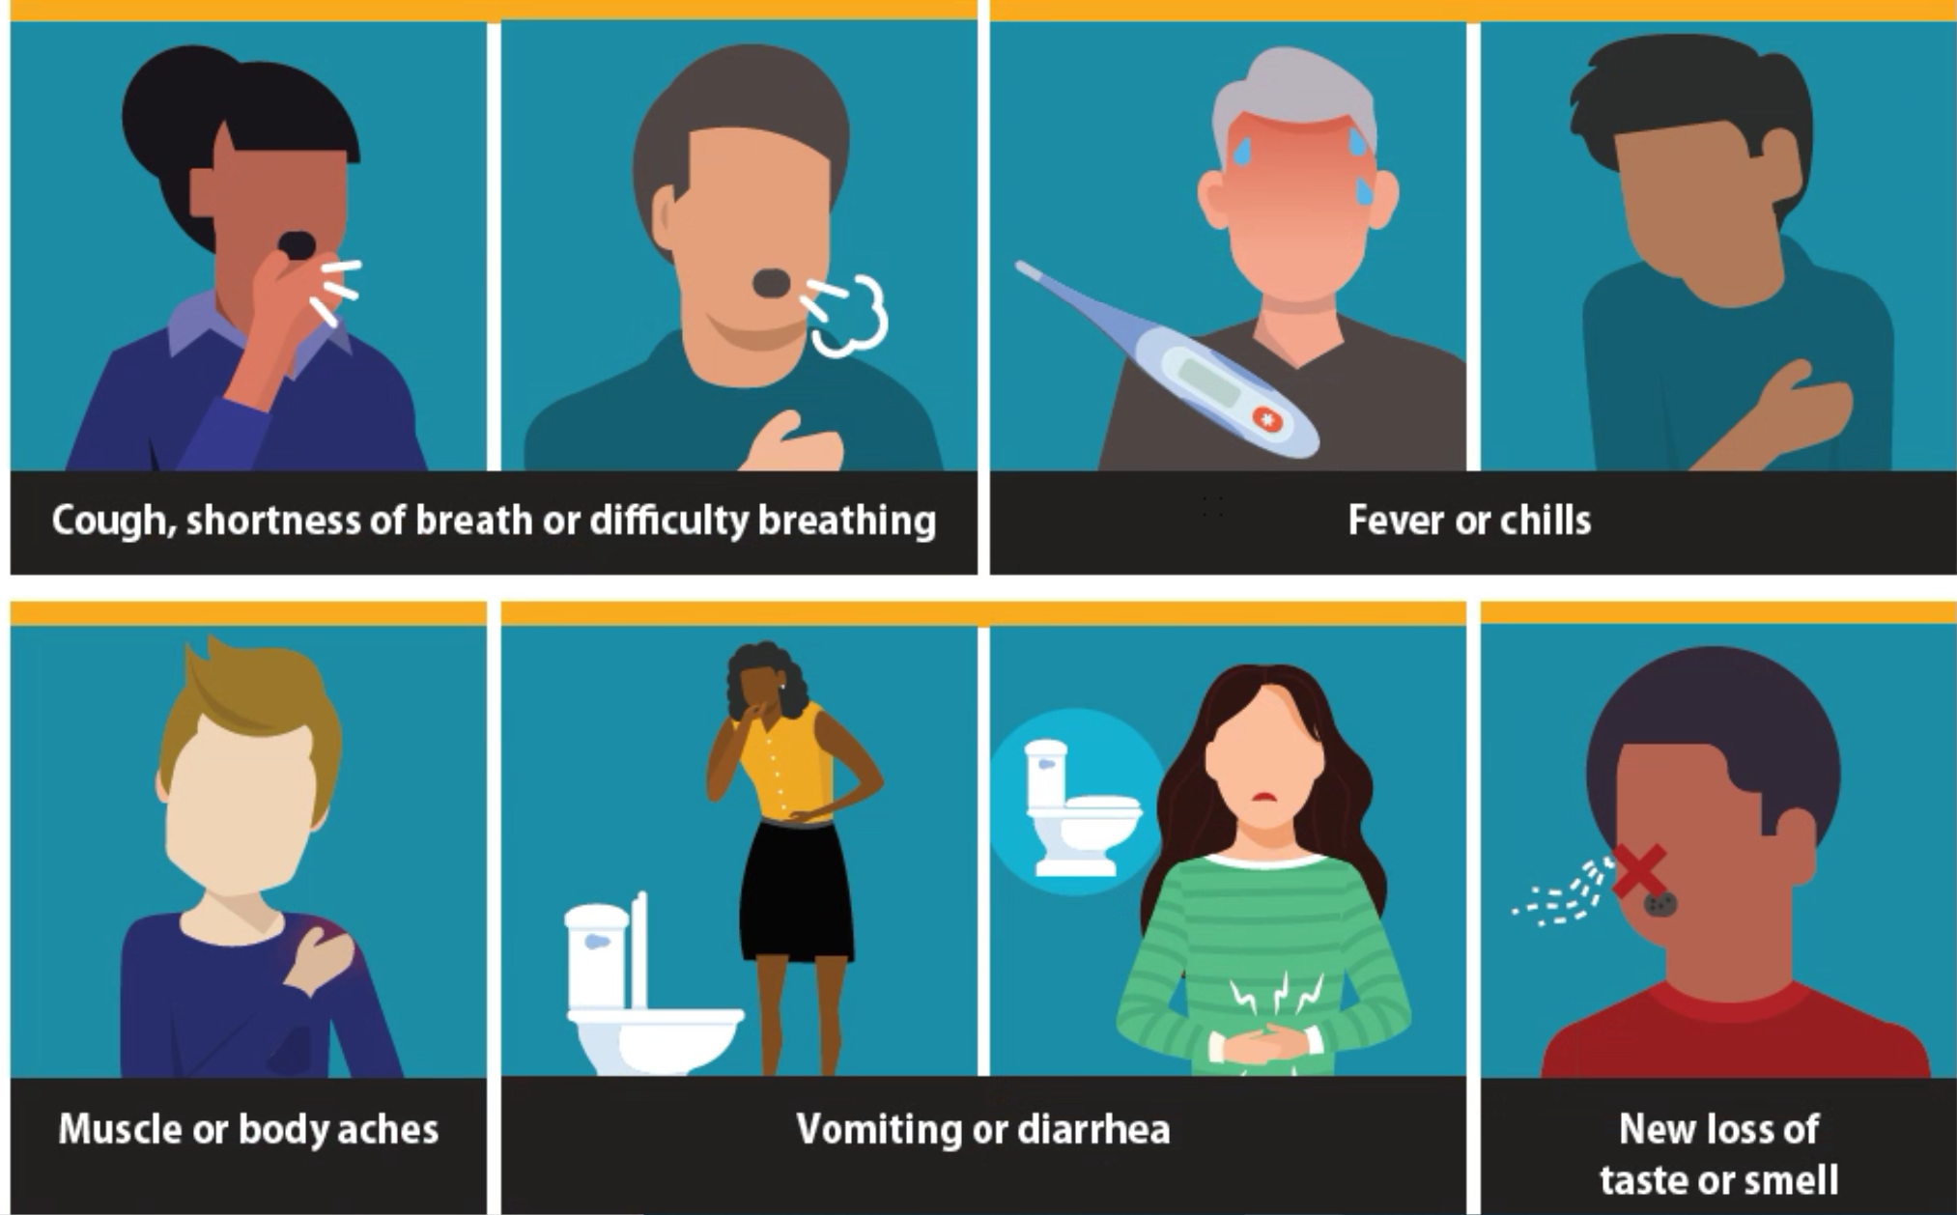
COVID-19: Symptoms
Notes:
Fever is 100.4 F/38 C
Seek immediate medical care if you have: trouble breathing, persistent pain/pressure in chest, new confusion, inability to wake/stay awake, bluish lips/face

Slide 61

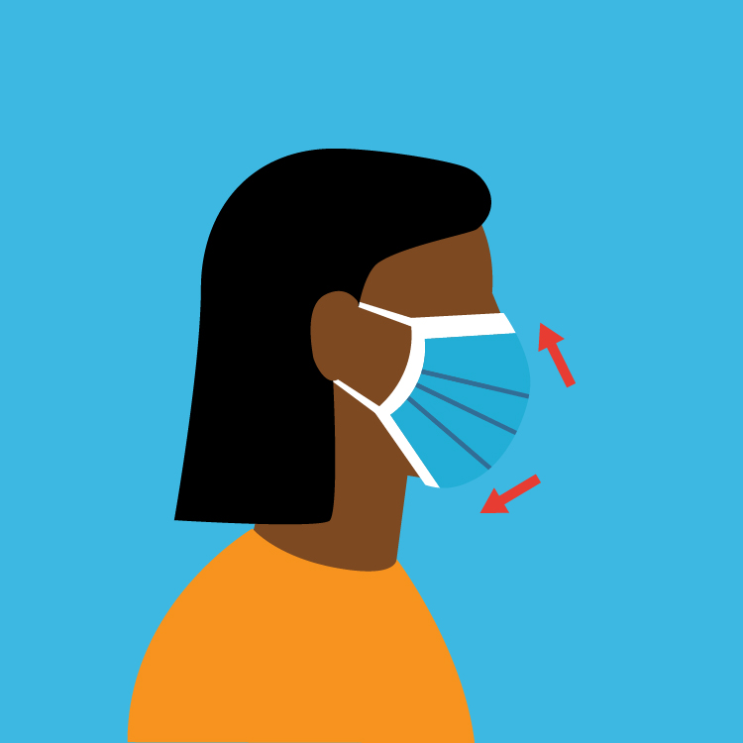

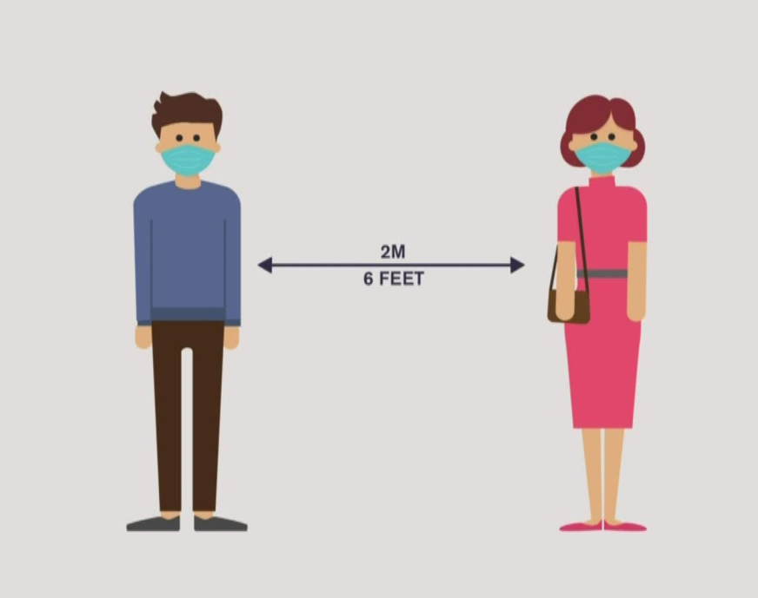

COVID-19: Protecting Yourself & Others
Notes:
Prevention: wear a mask anytime you’re in public (recommended for anyone over 2 years); avoid crowds; keep a 6 foot distance from others (non-household) at all times; wash hands often with soap and warm water (at least 20 seconds) or use hand sanitizer (at least 60% alcohol-based) when soap & water are not available; stay home (or outside in nature) except for necessary errands (groceries, laundromat, etc)/work/school.

Slide 62
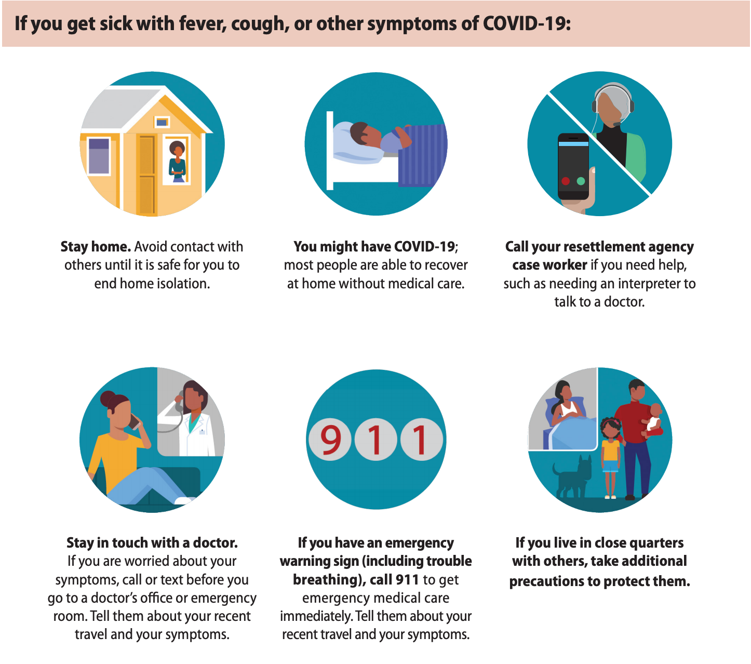
COVID-19: What to do if you get sick

Slide 63



Employment
It is expected that all able individuals between the ages of 18-60 will look for a job.
With your Social Security card and Employment Authorization Document (EAD/Work Permit) or Green Card you will have the right to work.
Your EAD card should come to IRIS’s office within 90 days (for refugees only).
Notes:
In the state of CT, people as young as 14 years old can get a job.

Slide 64



Finding a Job:
You do not need to wait for your job counselor to start looking for jobs. In the meantime reach out to family & friends and work hard at improving your English.
Your first job in the U.S. may not be exactly what you had hoped for or match your past experiences. You are expected to take your first job and can continue to look for other work once you gain more experience.
Notes:
You should stay at your first job for at least 6 months to build a good work history.

Slide 65
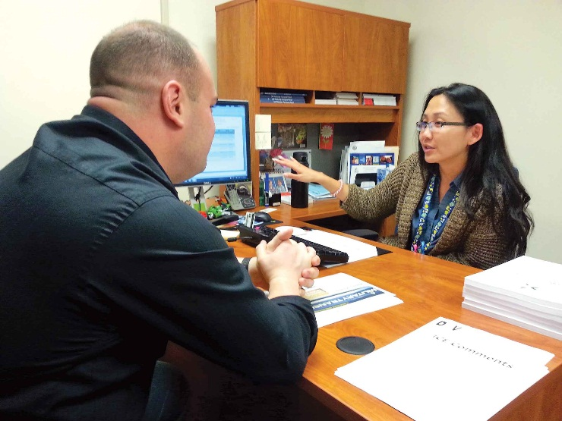

How an employment specialist is helpful:
  They will help you apply for jobs.
  They will teach you how to search for jobs.
  They will work with you on your resume and interview skills.
  They will help you overcome any barriers you may face in the workplace (example: childcare).
  They will also help you understand the culture of work in the U.S. and your rights and responsibilities as an employee.
Don’t wait for your job counselor to find you a job! Be actively searching yourself too! Ask friends, ask when you visit places if they are hiring.

Slide 66

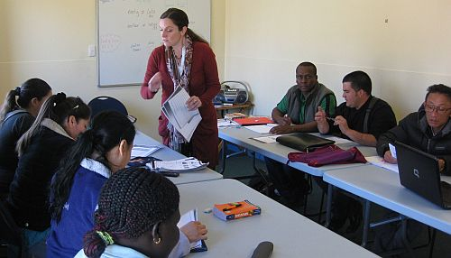
Learning English
Learning English is important to adjusting to life in the U.S. as well as finding a job.
You may be asked to report hours or have your school report hours to your job counselor.
There are many ways to learn English: attend English class, practice with family and friends, use it at the grocery store and other errands, even watch TV or listen to music.

Slide 67


Education
The U.S. provides free public education from Kindergarten through grade 12.
Transportation will be provided. Your child may need to walk if you live close to school.
It is the law that all school-aged children attend school. Schools take absences very seriously.
Consequences for unexcused absences vary (i.e., fine, police involvement, child protection). It is very important you call the school if your child is sick and you let them know so that you child’s absence is excused. If you think the weather is unsafe, call your school to make sure school is canceled, otherwise it counts as an unexcused absence. Biggest thing is communication with school!
Notes:
From CORE website:
There are many ways that parents can help and support their children even with limited English. Here are some ways refugee parents can get involved with their children’s education:
Find out if the school offers school tours or an orientation in the summer before school begins.
Ask your child what s/he learned about in school that day.
Ask your child what they have for homework or check their assignment book or homework folder.
Attend ESL classes, if offered, at your child’s school.
Attend parent-teacher conferences.
Help with an extracurricular activity such as a school sports team or an art club.
Volunteer in your child’s classroom.
Walk your child to the bus or school.
Work with your child on her/his homework.

Slide 68
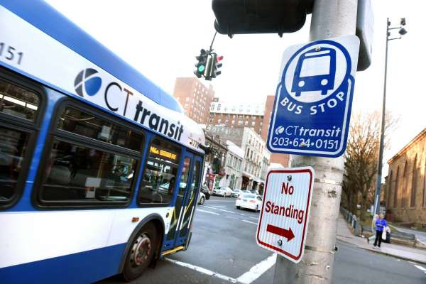
Transportation
What was transportation like in your previous country?
Public transportation:
Bus Fare –
$1.75
Each time you pay, you can take any other bus for free for the next 2 hours.
If you choose to drive a car, you NEED a driver’s license and car insurance.
This means you must pass a CT driver’s test.
A state ID is not a driver’s license.

Slide 69



Common U.S. Cultural Norms
Asking Questions is respected. People appreciate when others try to learn and understand.
Greetings- Americans often shake hands as a greeting.
Punctuality- Being on time in the U.S. is very important. If you are going to be late or need to cancel, it is important to call and let the other person know.
Privacy- Many Americans value privacy. It is important to call before you visit. This also explains why your case manager cannot always call agencies without you on the phone with them.
Notes:
Can demonstrate how to avoid shaking hands with opposite gender if goes against beliefs (hand over heart).

Slide 70

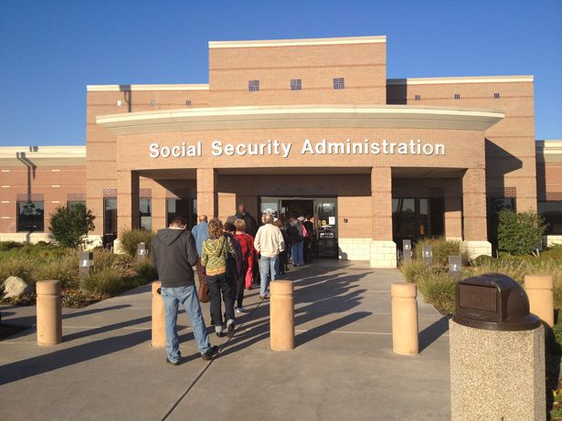

Common U.S. Cultural Norms
Rules- It is important to follow rule and order (i.e. waiting in lines, respecting public property, etc.).
Freedom of Expression- People in the U.S. value the right to freedom of opinion and expression. While you may not agree with someone else’s beliefs/decisions, their right to express themselves is protected under law. It is not culturally appropriate to enforce your opinion on others. Instead of focusing on differences, focus on commonality!
Family Life- In many families both parents work and share childcare/household responsibilities. American family dynamics may be a bit different than you are used to. Let’s talk a bit more about this!

Slide 71
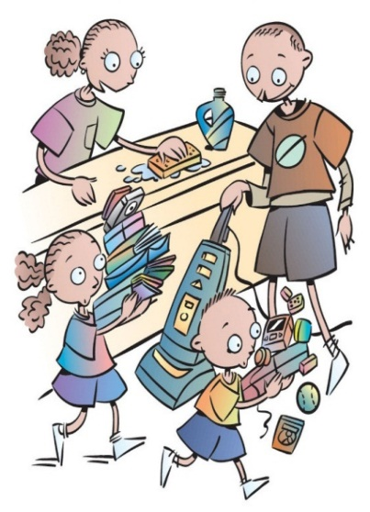



Family Roles
In the U.S., both males and females are expected to work outside the home as well as care for the household.
Parents: Expectations of parenting may be different than in your home country.
  Many times children adjust and learn English more quickly. If children end up helping you communicate it does not take away your right to make a decision as the parent. Remember many offices are required to provide an interpreter so you do not need to rely on your children.
Elderly: Those who are older may have a very difficult time adjusting to life in the U.S., especially if they do not attend English classes or work.
  Include them to be part of the family’s decision-making processes.
  Find somewhere they can go to socialize (a neighbor’s, a community center, a garden) or certain household responsibilities they can take on while other family members are at work or school.

Slide 72
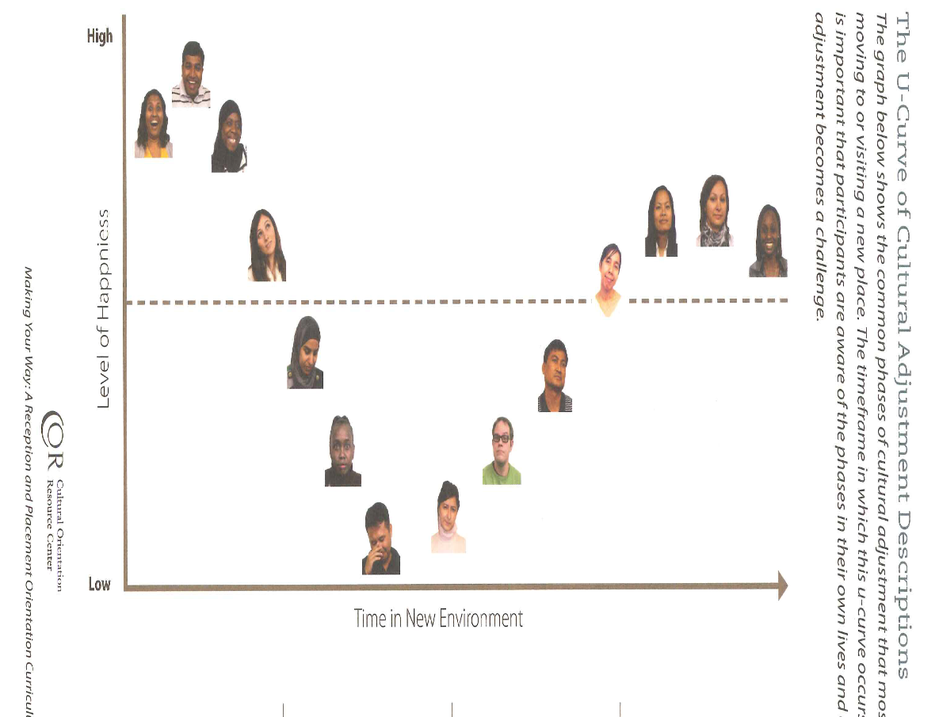
9. Cultural Adjustment
Adjusting to life and culture in the U.S. is not easy. It’s normal to experience culture shock, which includes different phases of adjustment. Keep in mind you may go back and forth between phases and that the time spent in each phase be different for each person.
Notes:
From CORE website: You may need 2 to 5 years to adjust fully to life in your new community. Your adjustment will be easier if you work together with those who are helping you. Being patient, keeping an open mind, and learning healthy ways to cope with stress and culture shock can help ease the process. Finding a job and learning English will also help you adjust. Learning to live in a new culture is not easy, but it can also be a good experience as you learn new things and gain new skills.

Slide 73
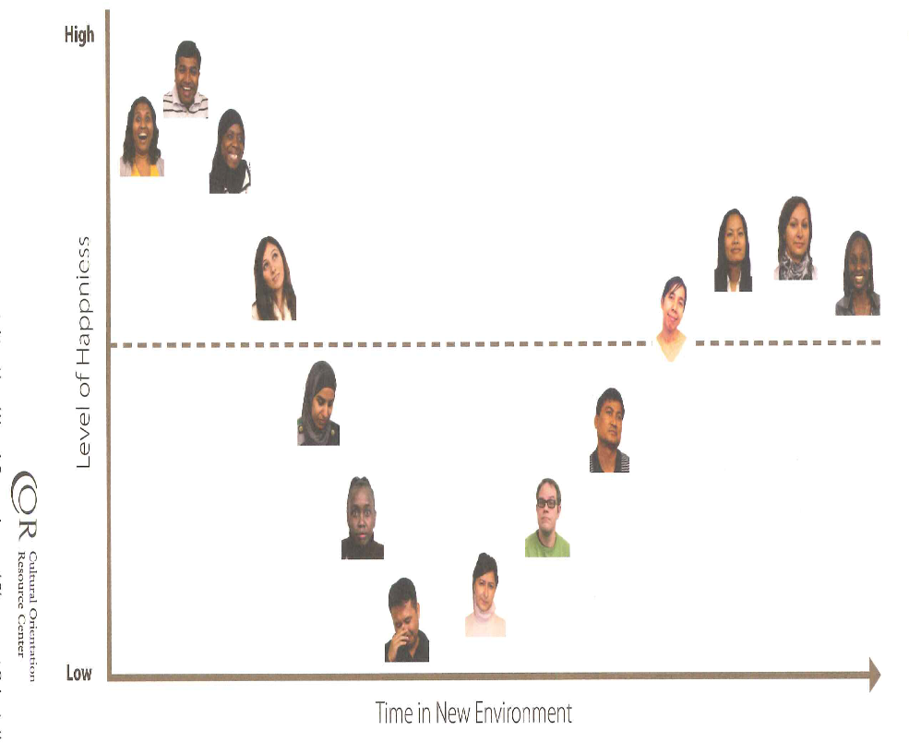
Cultural Adjustment
Mastery Phase: A feeling of comfort with your life in the US and the new culture. Remember there will still be difficult periods even in this phase.
Adjustment phase: After a while, you will begin to understand this new culture and community and settle into a routine. You will become more confident, independent and able to do things on your own.
Honeymoon Phase: Feelings of excitement and happiness, when everything is new and good.
Homesick/grief Phase: Soon, you will probably begin to miss your homeland and the family and friends you left behind. You may feel sad or discouraged.
Frustration Phase: As time passes reality may not meet your expectations. Life can become very hard, and you may feel like you are not getting the help you need. You may feel negative, angry, or frustrated towards American culture and your new circumstances here.

Slide 74




Cultural Adjustment
What are some things you do to help ease the stress of cultural adjustment?

Slide 75


Managing Stress
Talk to family, friends and neighbors who also understand what you are going through.
Other ideas include exercise, praying/meditating, keeping a routine, spending time in nature, etc.
If you are feeling hopeless and nothing seems to be getting any easier, it may be helpful for you to talk to a mental health professional (IRIS has one on staff).

Slide 76

Any Questions??

Slide 77

Thank you for participating in orientation!

