Slide 1
Legal

Slide 2
Rights & Responsibilities
You are entitled to all the protections given to an American citizen..
You also have rights and responsibilities specific to your refugee status.
Notes:
NOTE: To be added somewhere later. You do NOT have the right to vote in any U.S. election (federal, state, or local) until you become a citizen. Voting before becoming a citizen is considered voter fraud and can keep you from becoming a citizen, even if you voted without knowing you weren’t eligible to.

Slide 3
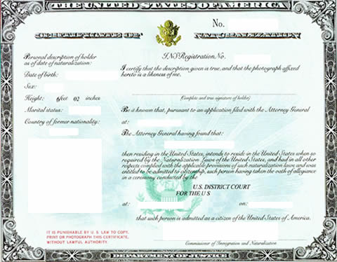
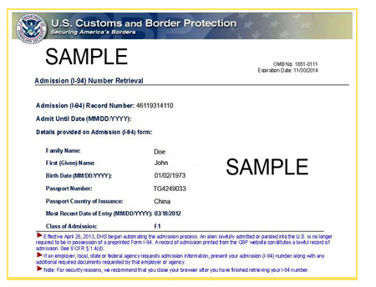
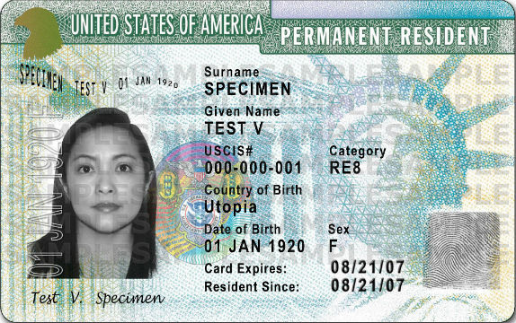
Path to Citizenship
Path To Citizenship
One Year
After Arrival =
Apply for Green Card
Five Years After Arrival=
Apply for Citizenship
Arrive in US- Refugee Status
Status Change to Legal Permanent Resident
Status Change to Citizen
It is always best to apply for a green card/citizenship with the help of an attorney
Document to show status
I-94= Refugee Status
Green Card = Permanent Resident
Citizenship Certificate
Note: It is illegal to vote before you are a U.S. citizen.
Notes:
For SIVs, can shorten to just “you have the right to apply to become a U.S. citizen after 5 years.”

Slide 4
Family Reunification
You can apply for a spouse or unmarried child under 21 to join you in the U.S. within the first 2 years you are here.
After receiving a green card, you may apply for a spouse or unmarried children (of any age) to join you in the U.S.
After receiving a green card, you may apply for a spouse or unmarried children (of any age) to join you in the U.S
Another program allows you to apply for a spouse, unmarried child (under 21), or parent within your first 5 years in the U.S. (Affidavit of Relationship, AOR – they must have their own refugee claim but can bring other immediate family members on their case).
Once you are a citizen, you can apply for married children and siblings, as well..
If you think you may qualify now to apply for family members, make an appointment with an IRIS lawyer to learn about your options.
IRIS's Immigration Legal Services can assist you!
Notes:
Some of these programs are subject to change based on changing legislation.

Slide 5
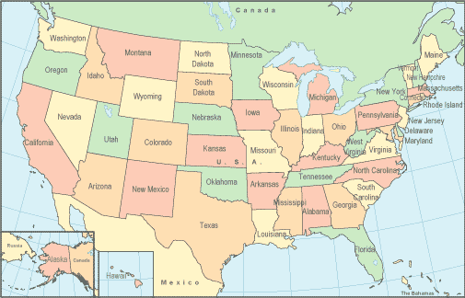
Travel for Refugees
IRIS strongly discourages travel outside the U.S. prior to obtaining a green card
If you do travel abroad you must apply for a travel document to get permission.
You cannot use this document to return to your country of origin. You will be allowed to leave the US but you may not be allowed to re-enter the country.
If you travel abroad during your first year in the U.S., it may delay when you qualify for a green card (you must be physically present in the U.S. for a total of one year to be eligible for a green card)
Where can you travel freely right now?
Any where within the country – All fifty states
Notes:
SIVs can travel with just their green cards, but they shouldn’t be outside of the U.S. for more than 6 months at a time, as they may jeopardize their permanent resident status if they do so.

Slide 6
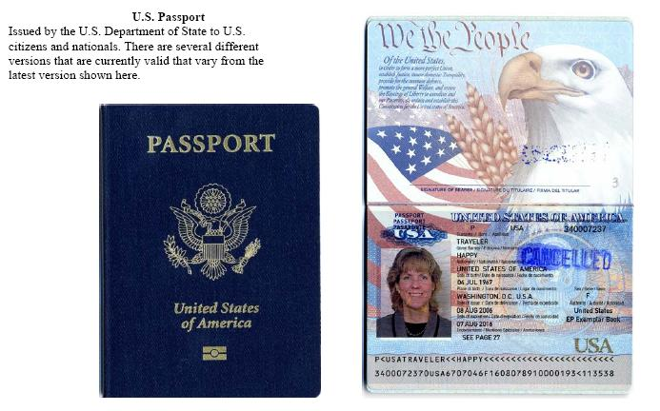
Travel for U.S. Citizens
Once you become a US citizen you can apply for a US Passport. Then all travel restrictions are gone and you may travel freely.

